Slide 1
Caesar cipher
Team:
1-Omar Atef
2-AbdElrahim Saad
3-Hassan Mohammed
4-AbdElrahman AbdElrahim

Slide 2
Problem:
We will be deciphering encrypted messages in this problem.
The idea of the algorithm is simple. Each letter of the original text is
substituted by another, by the following rule:
* find the letter (which should be encrypted) in the alphabet;
* move |K| positions further (down the alphabet);
* take the new letter from here;
* if "shifting" encountered the end of the algorithm, continue from
its start.

Slide 3
For example, if |K = 3| (shift value used by Caesar himself), then |A| becomes |D|, |B| becomes |E|, |W| becomes |Z| and |Z| becomes |C| and so on
according to the following table:
A B C D E F G H I J K L M N O P Q R S T U V W X Y Z
D E F G H I J K L M N O P Q R S T U V W X Y Z A B C

Slide 4
Input
The input is : number of lines , shift value and an encrypted text
for example:
2 3
  HYHQ BRX EUXWXV.
  L ORYH BRX .
*letters must be UPPERCASE

Slide 5
output
The output is an decrypted(original) text
HYHQ BRX EUXWXV. EVEN YOU BRUTUS.
L ORYH BRX . I LOVE YOU.
*the output is also in upper case and in single line
*each text is terminated with .

Slide 6
process
We handle each character of the text separately as following :-
1-check if the character is equal to space
If so then it left without being shifted
2-check if the character is equal to dot
if so then it left without being shifted
3-else it is a character (A~Z) . Then we apply this step:
character = character +( 26-shift value ) ##
if the character value > 90 then we subtract 26 from the character’s value
4- then repeat from step 1 to 3 till we reach the end of the text
5- then repeat from step 1 to 4 for each line
* Formula ## related to ASCII codes

Slide 7
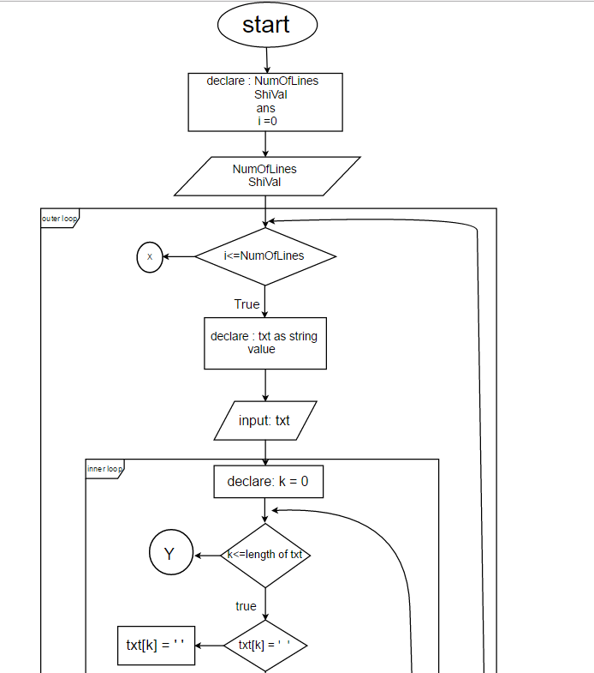
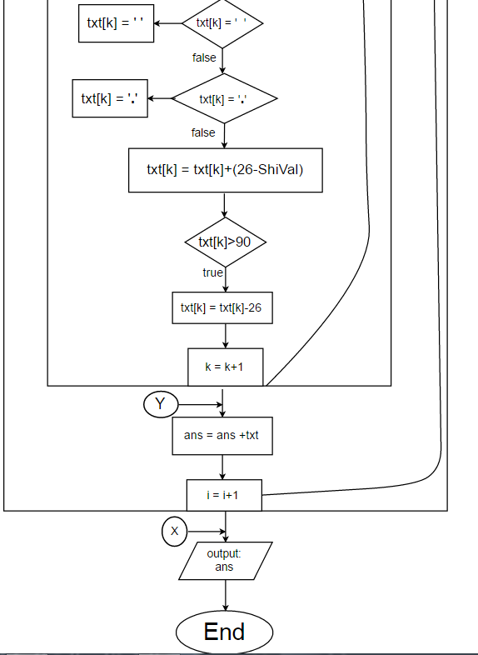
1
2

Slide 8
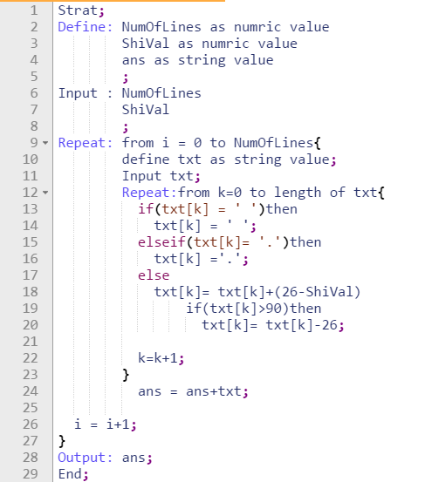

Slide 9
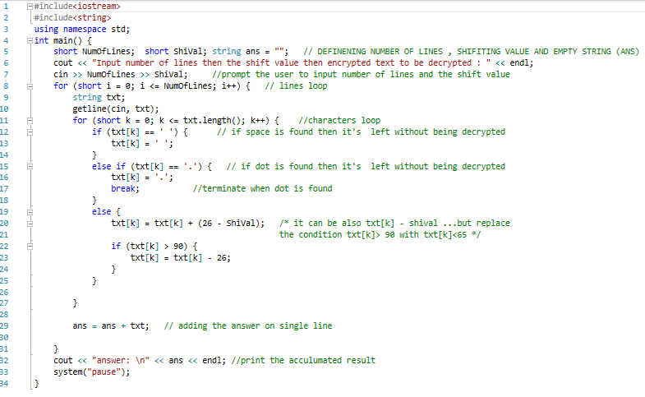
-

Slide 10
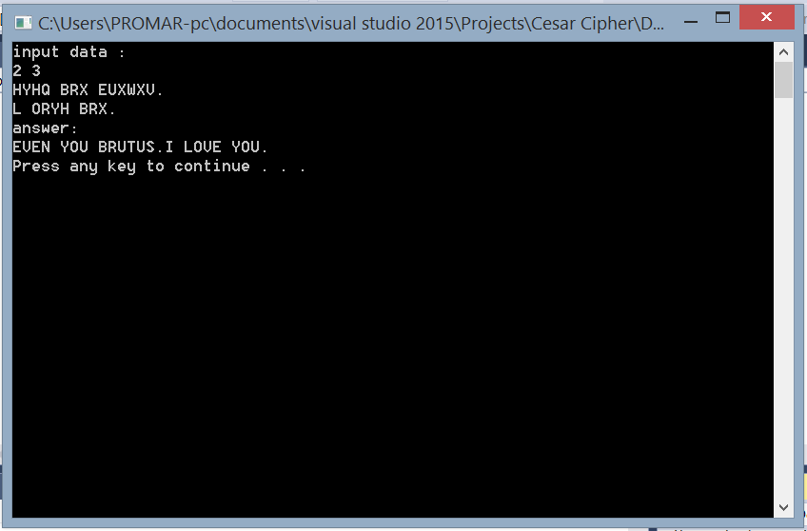

Slide 11
Thank You
☺

